Slide 1
RESPECTING MY EDUCATION
Becoming a Self-Regulated Learner

Slide 2
What does it mean to respect your education?
“Learning is not something that happens to students, it is something that happens by students.”
--Zimmerman (Self-Regulated Student Researcher)

Slide 3
THINK, PAIR, SHARE: What is this saying?
Processes | Underachievers | Achievers
Time Use | Are more impulsive | Manage study time well
Goals | Set low or unclear academic goals | Set higher specific goals
Self-Monitoring | Do not accurately monitor the quality of their work | Monitor frequently and accurately the quality of their work
Self-Efficacy | Are not effective in their work time | Are very effective and efficient in their work time
Motivation | Give up more readily | Persist despite obstacles

Slide 4
It’s not that students don’t have the ability to succeed. The problem is they have not acquired the tools necessary to learn.
What tools do you need to add to your toolbox in order to be a higher achiever?

Slide 5
RESPECT
Take out your RESPECT sheet from the page protector.
Under the second E on your RESPECT page:
Write one tool you will add to your toolbox in order to show you have RESPECT for your EDUCATION?
“This year, I will…”

Slide 6
If you know what makes some people achievers and others not, what goals should you set for yourself?
Processes | Underachievers | Achievers
Time Use | Are more impulsive | Manage study time well
Goals | Set low or unclear academic goals | Set higher specific goals
Self-Monitoring | Do not accurately monitor the quality of their work | Monitor frequently and accurately the quality of their work
Self-Efficacy | Are not effective in their work time | Are very effective and efficient in their work time
Motivation | Give up more readily | Persist despite obstacles

Slide 7
Pushing yourself to learn as much as you can and to adopt the habits of high achievers will require Commitment and Dedication.

Slide 8
TOAST for CHANGE
Let’s make that commitment!
From under your E, read the one change you promise to make, in order to RESPECT your EDUCATION.
SHARE for ACCOUNTABILITY!

Slide 9
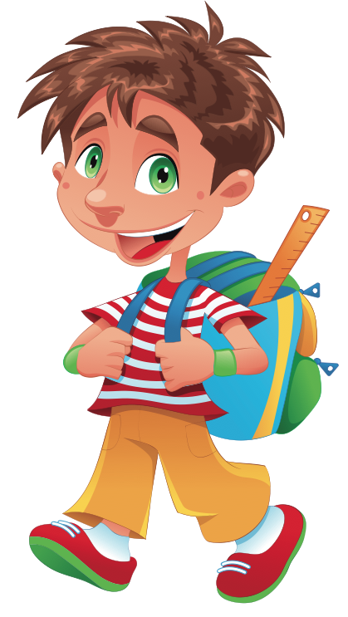
Rule 1 is “Build each other up!”
Respect each other

Slide 10
Rule 2 is “Make smart choices.”
Respect yourself

Slide 11
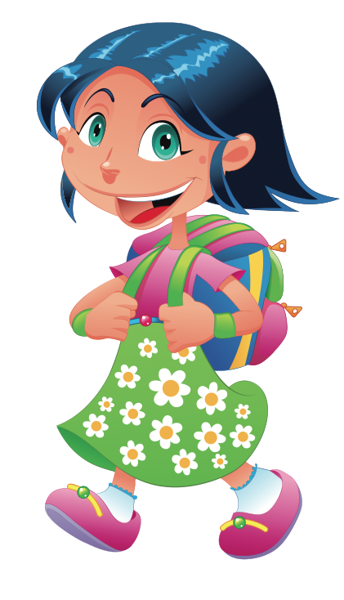
Rule 3 is “Leave everything better than before.”
Respect property

Slide 12
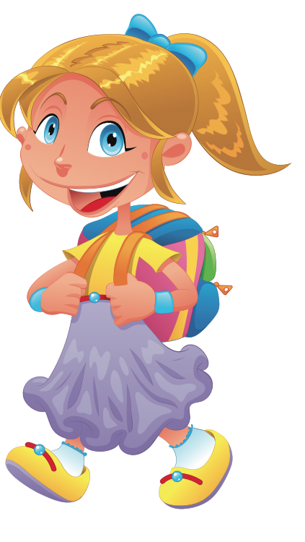
Rule 4 is “Give your best!”
Respect your education

Slide 13
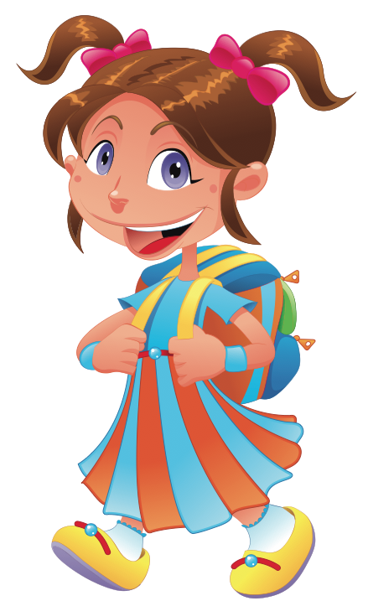
Rule 5 is “Keep your dear teacher happy!”
Respect your teacher

Slide 14
Add the rest of your binder sections…
SPEAKING and LISTENING
Page Protector for title page

Slide 15
SPEAKING and LISTENING
Bad Booktalk
Good Booktalk

