Slide 1
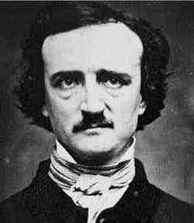
Edgar Allan Poe: Fact or Fiction?

Slide 2
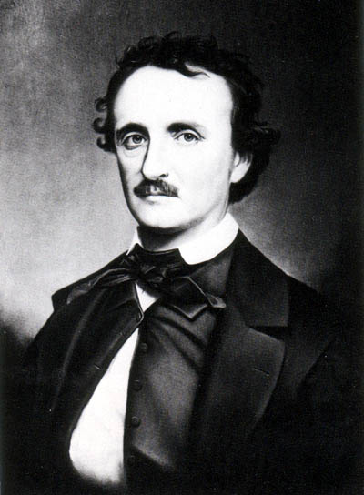
His life or his Stories? you decide…
Childhood
Career
Parents
Later Years
College Years
Death
Notes:
This is the home slide. Choose a category. Two descriptions will come up. One description is from Poe’s life and one is from one of Poe’s stories. Have students choose which description comes from his life and click the button underneath. Another slide will come up that tells them if they are right or not. If they are wrong, a description of the story will come up. On the “answer” slides there will be a “page” button on the bottom right that will take you back to the home slide again. If you have time, you can go back through the ppt again and choose the “wrong” answers to see the descriptions of the stories to peak student interest in possibly reading them. Definitely go through it yourself first so that you know how it works!!

Slide 3
Childhood…
Edgar Allan Poe’s parents were traveling actors in Boston. His father abandoned him when he was around three years old.
Edgar Allan Poe was born an orphan and stayed with his Uncle, an old Norwegian fisherman, until he was ten.

Slide 4
Parents…
Edgar Allan Poe’s mother died of tuberculosis at the age of 24. His father was an alcoholic.
Edgar Allan Poe’s mother was murdered. His father was a drunk who claimed he had hallucinations.

Slide 5
College Years…
Edgar Allan Poe solved a crime at the University of Virginia in which he recovered a stolen document of high value.
Edgar Allan Poe gambled and drank away his money at the University of Virginia and his foster father cut him off from all funding.
Notes:
5

Slide 6
Career…
Edgar Allan Poe was a detective who traveled to Europe during the Spanish Inquisition.
Edgar Allan Poe joined the army, was a critic, and married his first cousin when she was thirteen.
Notes:
6

Slide 7
Later Years…
Edgar Allan Poe’s wife died at the same age and of the same disease as his mother.
Edgar Allan Poe’s wife was a little nuts, despised cats, and destroyed two of them.
Notes:
7

Slide 8
Death…
Edgar Allan Poe died of tuberculosis and asked a friend to hypnotize him before he died.
Edgar Allan Poe died of unknown causes.
Notes:
8

Slide 9
You’re Right!!

Slide 10
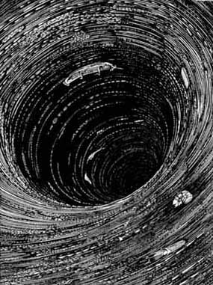
WRONG!
In Edgar Allan Poe’s, “A Descent Into the Maelstrom”, a man listens to the story of an old Norwegian fisherman who tells him of the horrifying experience that turned his hair white in one day.

Slide 11
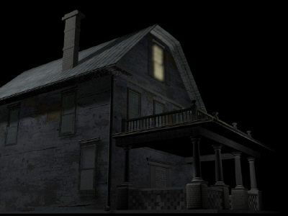
WRONG!
In Edgar Allan Poe’s, “The Murders in the Rue Morgue”, two women are brutally murdered in a room where no one could have entered or exited. In “Angel of the Odd”, the main character is a drunk who meets a strange character.
Notes:
11

Slide 12
WRONG!
In Edgar Allan Poe’s, “The Purloined Letter”, C. Auguste Dupin, Poe’s famous character detective, solves a crime in which he easily recovers a stolen document CSI style.
Notes:
12

Slide 13
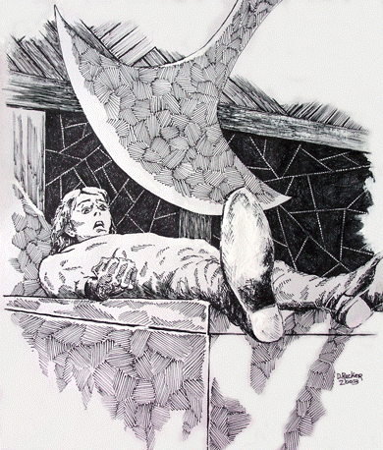
WRONG!
In Edgar Allan Poe’s, “The Pit and the Pendulum”, the main character tried to survive a torture chamber during the Spanish Inquisition.
Notes:
13

Slide 14
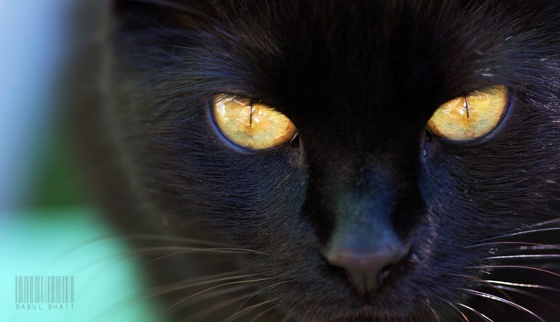
WRONG!
In Edgar Allan Poe’s, “The Black Cat,” the drunk main character kills his cat and then believes it has come back to haunt him.
Notes:
14

Slide 15
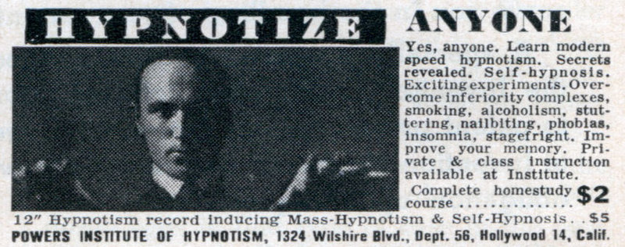
WRONG!
In Edgar Allan Poe’s, “The Facts in the Case of M. Valdemar”, the dying main character asks to be hypnotized before death. Interesting things ensue…
Notes:
15

