Slide 1
UNIT 10 VOCABULARY: PHOTO GALLERY

Slide 2
Let’s keep going…
THE BIG QUESTION:
Can this strategy CONTINUE to improve our learning?

Slide 3
THE DIRECTIONS
Each day, in addition to the daily vocabulary review/homework, we will also go through the 20 images that follow this slide.
You will call out the correct word as a class.
We should be getting quicker at going through the PowerPoint each time!

Slide 4
re
re

Slide 5
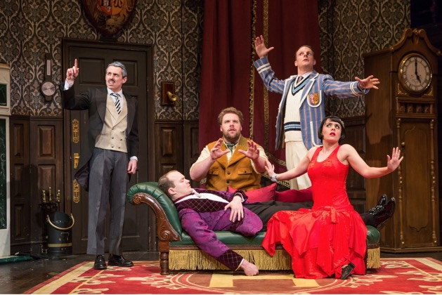
re
re

Slide 6
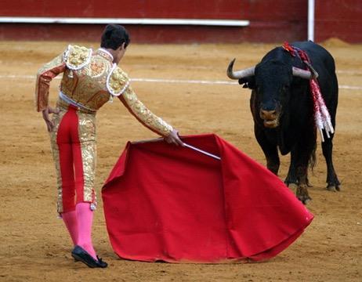
re
re

Slide 7
re
re

Slide 8
re
re

Slide 9
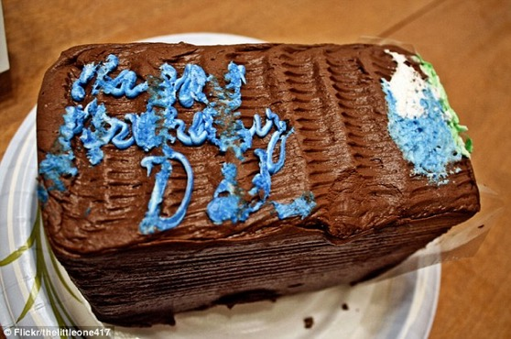
re
re

Slide 10
re
re

Slide 11
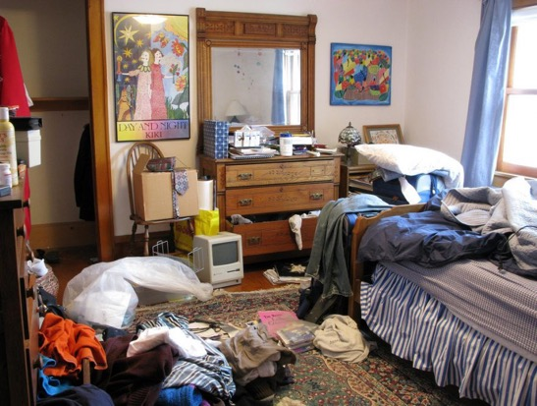
re
re

Slide 12
re
re

Slide 13
re
re

Slide 14
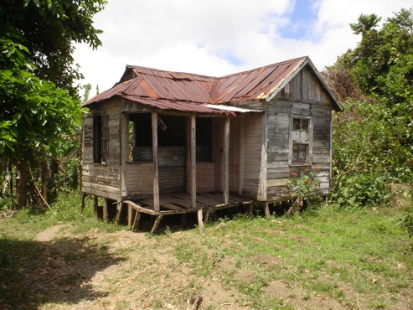
re
re

Slide 16
re
re

Slide 17
re
re

Slide 18
re
re

Slide 19
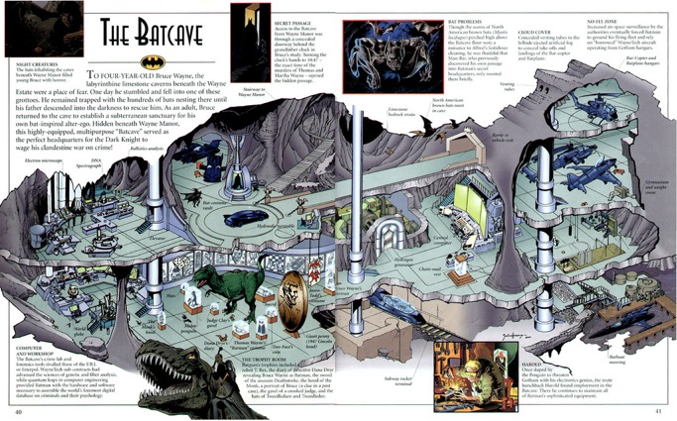
re
re

Slide 20
re
re

Slide 21
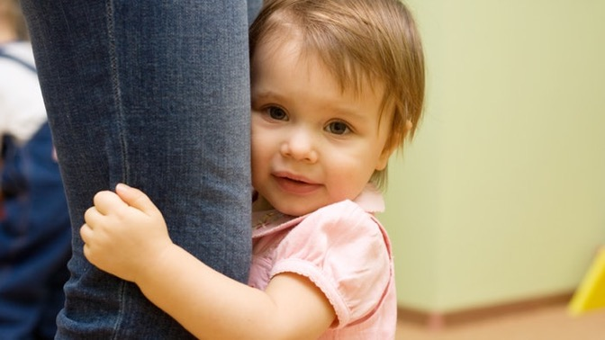

Slide 22
re
re

Slide 23
re
re

